Slide 1
Financial Incluion in Africa

Slide 2

Agenda
Our team
Client case
Hypotheses
Client profile
Our model

Slide 3
Our Team
We are a Financial analytics solutions provider.
We offers tailored data analysis and machine learning solutions for financial providers.
Data scientists:
Alex Volosha
Hiroi Isomura
Ron Silva

Slide 4
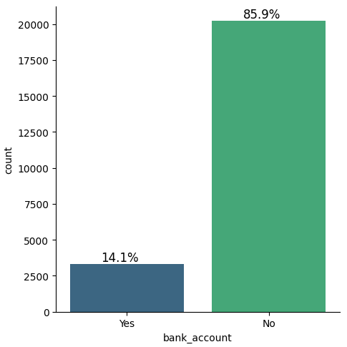
Our Client Case
Who in Africa is most likely
to have a bank account?
Only around 14% of adults have a bank account
in Kenya, Rwanda, Tanzania and Uganda
Our goal is to develop a model that can predict
which individuals are most likely to have or use
a bank account.
Number of people
Have a bank account?

Slide 5
Hypotheses for bank holder’s profile
People from specific country has more access to bank account.
Most people that don't have bank account are from rural area.
People with cell phones have no bank account.
People with high education have more access to bank account.
People who are employed have more access to bank account.

Slide 6
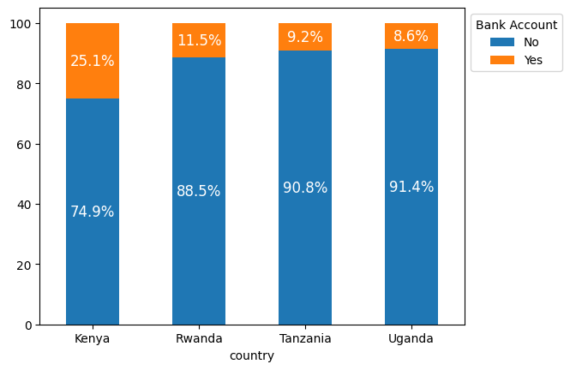
Bank Account Holder Rate per Countries

Slide 7
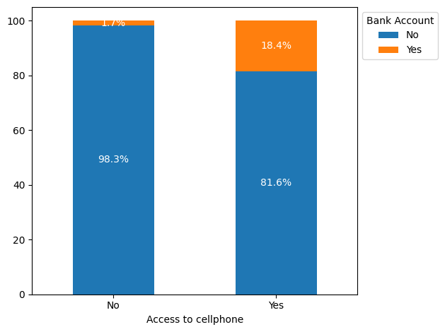
Bank Account Holder Rate per Cellphone Possession

Slide 8
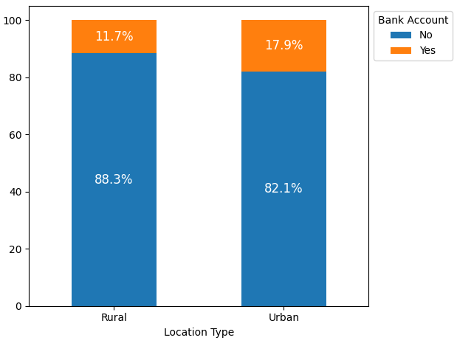
Bank Account Holder Rate per Location Type

Slide 9
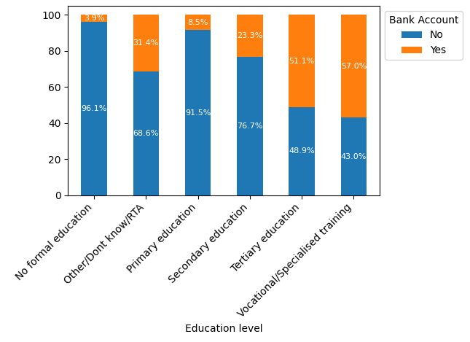
Bank Account Holder Rate per Education type

Slide 10
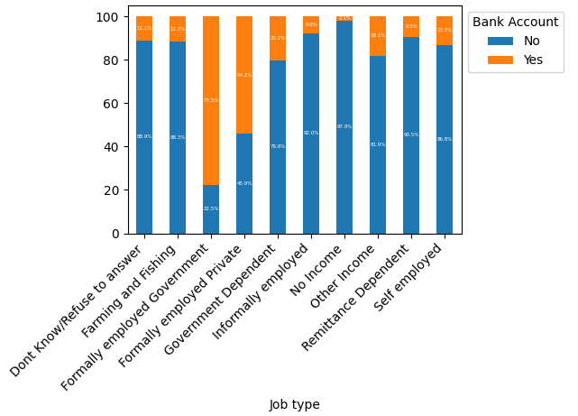
Bank Account Holder Rate per Job type

Slide 11
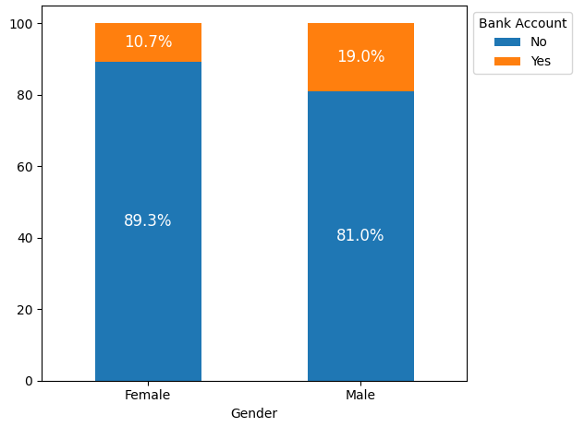
Bank Account Holder Rate per Gender

Slide 12
Hypothesis for bank holder’s profile
People from specific country has more access to bank account.
Most people that don't have bank account are from rural area.
People with cell phones have no bank account.
People with high education have more access to bank account.
People who are employed have more access to bank account.

Slide 13
The potential client
A man, between 30 and 40 years old, with a cell phone, from an urban area, with a technical or graduation degree, and formally employed is more likely to have a bank account.

Slide 14
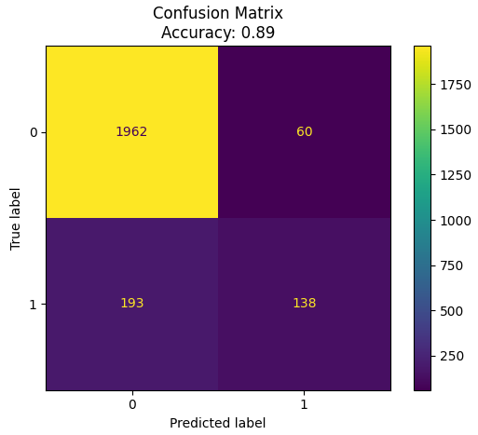
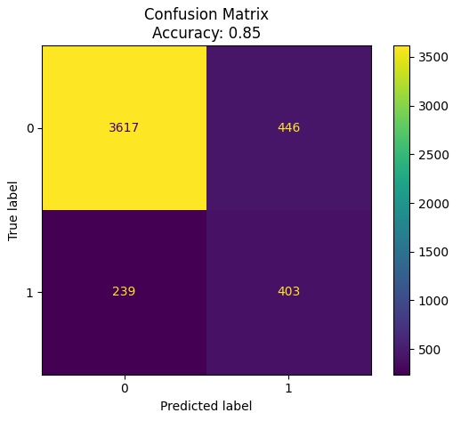
Basis model
Final model
High TP = True Positive. Most importantly to capture potential clients.
Notes:
Basis model -> XGBoost Final model -> Ensemble method Weighted Average (LogisticRegression, KNeighborsClassifier, RandomForest)

Slide 15
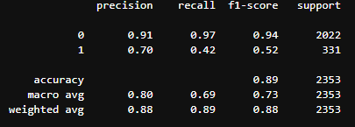
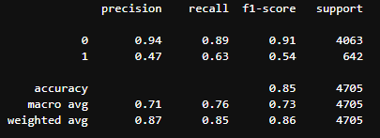
Basis model
Final model

Slide 16
Basis model
Final model
Higher FP = False Positive could be double-checked

Slide 17
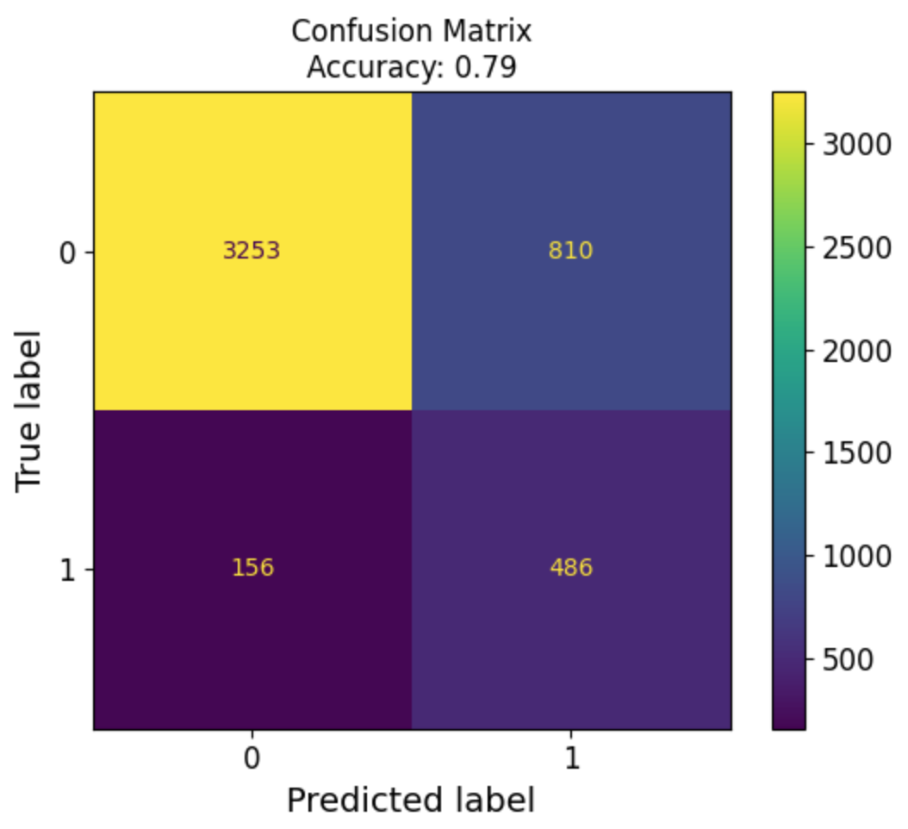
Basis model
Model 2
Higher FP = could be double-checked(worse precision)
recall = 0.75

Slide 18
Thanks!

Slide 19
Extra

Slide 20
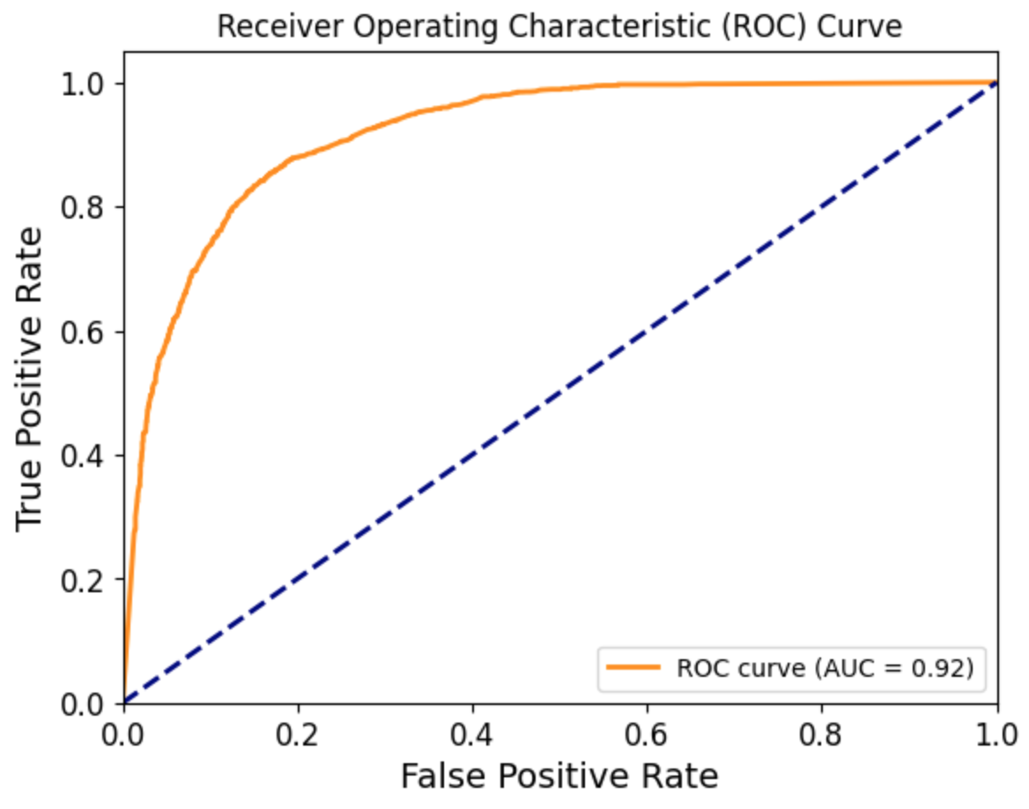

Slide 21
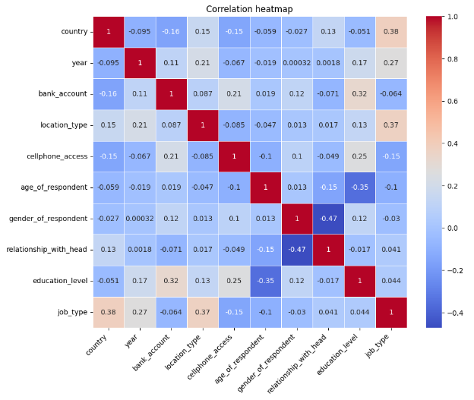

Slide 22
Next steps
If the client agrees to double-check the analysis. We will tune the model to capture as many potential customers as possible.

